Slide 1
How Can Racism be Stopped
Group Presentation
Presented by-
Rimpy Vincent Gomes &
Sadik-Ul-Islam Khan

Slide 2
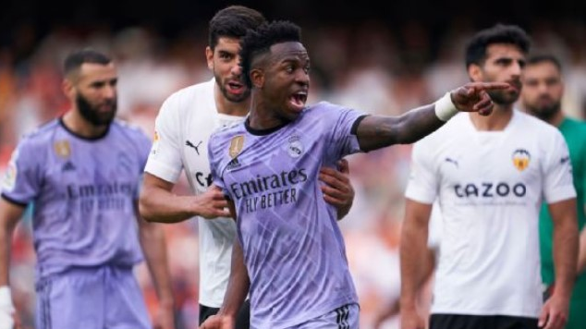
Racism in Football Field
Brazil & Real Madrid star Vinicius tried to confront fans at Valencia in May 2023 after hearing their racial abuse directed towards him from the stands.

Slide 3
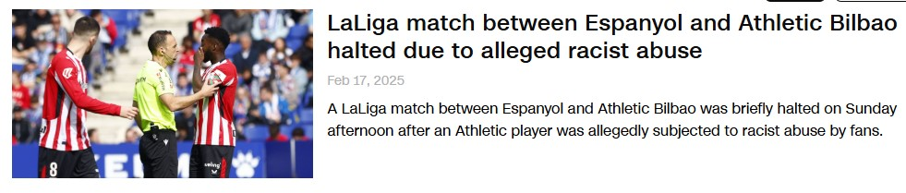
Another Disturbing Moment
A recent report from CNN on Feb 17,2025

Slide 4
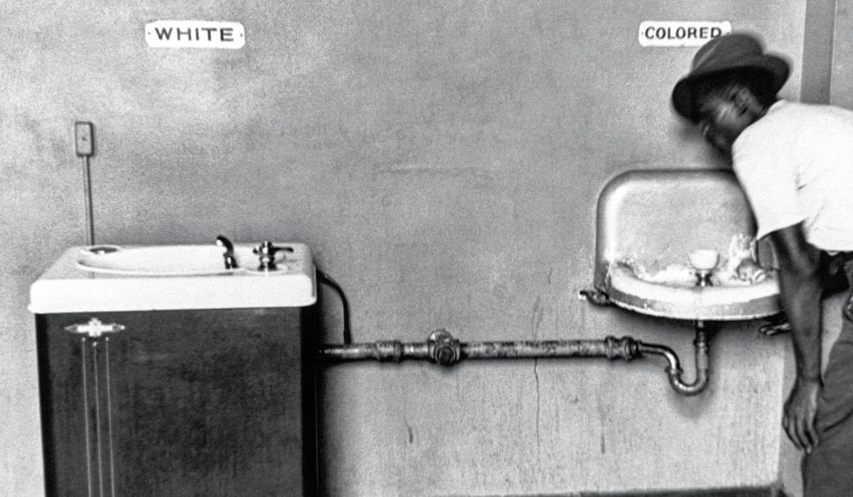
What Is Racism ?
Racism is discrimination or prejudice based on race, leading to unequal treatment and injustice .
“Racism is not an opinion. It’s a crime”- Anonymous.

Slide 5
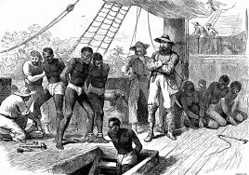
The Roots of Racial Injustice
The Portuguese Enslavement
In the 1440s, Portugal began the Atlantic slave trade, capturing and transporting Africans to colonies like Brazil. Over 6 million people were enslaved, establishing racial hierarchy and fueling colonialism for centuries.
long-term effects
Racial hierarchy and colonialism.
Systemic racism in Europe and the Americas.
The forced labor economy and cultural loss.

Slide 6
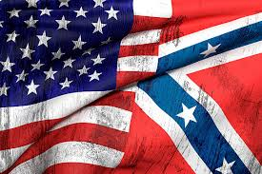
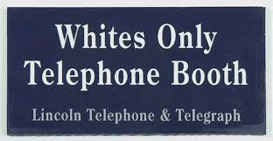
The American Civil War: A Fight Over Slavery and Its Aftermath
Why the Civil War Started ?
Slavery was the main issue between the North (Union) and the South (Confederacy).
The Southern states wanted to keep slavery because it supported their economy.
The North wanted to abolish slavery and keep the U.S. united.
In 1861, the Southern states seceded, and the war began.
What Happened After?
1865: The North won, and slavery was abolished (13th Amendment).
But racism didn’t end. Instead, it took new forms:
Black Codes & Jim Crow laws enforced segregation.
KKK & racial violence against Black Americans.
Voting restrictions (poll taxes, literacy tests).

Slide 7
Racism Today: How It Still Affects the World
Past Racism (Before the 21st Century)
Slavery & Segregation (U.S. & Colonialism):
Racial discrimination legalized through slavery and apartheid.
Example: Slavery in the U.S. (ended in 1865) and apartheid in South Africa (ended in 1994).
Racist Laws & Policies:
Laws enforcing racial separation and inequality.
Example: The Jim Crow Laws in the U.S. (segregation), Black Codes, and apartheid laws in South Africa.
Violence & Hate Groups:
Violent racism by groups like the Ku Klux Klan (KKK).
Example: Lynching of African Americans in the U.S. during the 20th century.
Limited Rights & Representation:
People of color had limited voting rights and were excluded from many opportunities.
Example: Disenfranchisement of Black Americans, and racial exclusion in many workplaces.
Modern Racism (Today)
Systemic Racism in Institutions:
Discrimination still exists in education, healthcare, jobs, and housing.
Example: Racial gaps in education achievement, healthcare access, and income inequality.
Police Brutality & Hate Crimes:
Racial violence and profiling still exist today.
Example: George Floyd and Breonna Taylor cases; hate crimes targeting racial minorities, such as the Charlottesville rally.
Racism in Media & Social Media:
Stereotyping, racial slurs, and harassment still happen online and in media.
Example: Viral instances of racist memes or discriminatory media coverage of racial minorities.
Activism & Protests:
Despite progress, protests continue, calling for racial equality and justice.
Example: #BlackLivesMatter, #StopAsianHate, #MeToo, and other movements fighting for racial justice.

Slide 8
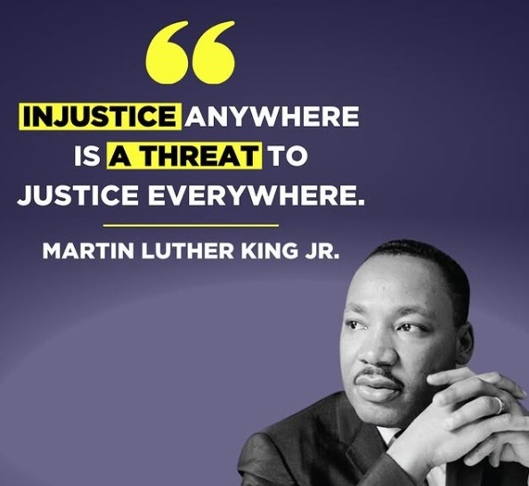
The Fight Against Racism Begins

Slide 9
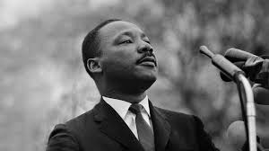
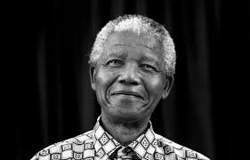
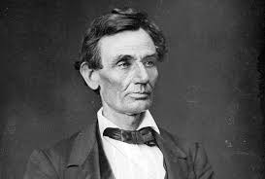
Icons Who Stood Against Racism
Martin Luther King Jr.
Led U.S. Civil Rights Movement, promoted nonviolent resistance & fought against segregation.
Nelson Mandela
Fought against apartheid in South Africa and became countries first black president.
Abraham Lincoln
Abolished slavery in the U.S. by signing the Emancipation Proclamation in 1863.

Slide 10
How Can We Help?
Educate Yourself 📕 | Read books/articles about racism and history.
Speak Up 🗣 | Call out racist behavior when you see it.
Support Organizations 🤝 | Donate to or volunteer for anti-racism groups.
Use Your Voice 📱 | Share awareness on social media platforms.

Slide 11
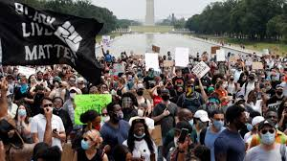
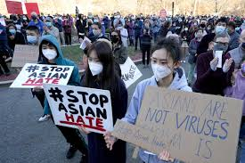
The Power of Social Media
George Floyd & the Black Lives Matter Movement (2020)
A video of George Floyd ‘s murder by a police officer was shared online.
Millions posted #BlackLivesMatter and called for justice.
Protests spread in 60+ countries, leading to police reform debates.
#StopAsianHate Movement (2021)
A rise in hate crimes against Asian communities during COVID-19.
Celebrities and activists raised voices using #StopAsianHate.
Millions signed petitions demanding government action.

Slide 12




Global Organizations Against Racism
Organizations | Mission & Impact
NAACP National Association for the Advancement of Colored people. | Works to eliminate racial discrimination and advance civil rights through legal action, education, and advocacy.
AMNESTY INTERNATIONAL | Defends human rights worldwide, including racial justice, by pressuring governments and exposing injustice.
UNESCO | Promotes anti-racism education and policies on a global scale, helping create more inclusive societies.
UNITED NATIONS HUMAN RIGHTS | Works with governments to implement anti-racism policies and ensure justice for victims of racial discrimination.

Slide 13
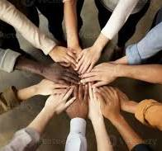
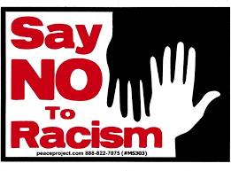

Change Starts With US
🗣 “Not everything that is faced can be changed, but nothing can be changed until it is faced.” – James Baldwin

